Slide 1



Slide 2


We aim to…
Drive the adoption of Wave and Tidal Energy with a tool powered by accurate information useful for prospection, planning and operation of underwater and overwater power generators.

Slide 3



Team
Marco Marín
👨🏽‍💻 🍴 🏄🏽‍♂️
Software Engineer
Computer and Telematics Engineer, M.Sc.
Experience with Wireless, GIS, ML, data visualization.
Interested in business, finance and entrepreneurship.
Natalia Espinosa
👷‍♀️🥑💡
Data Engineer
Electrical and electronics Engineer, M.Sc.
Experience in MV/HV networks, data analysis.
Interested in data science, grid management and energy.
Álvaro Carpinteiro
⚙💱🚀
Business Manager
Electrical and electronics Engineer, M.Sc.
PhD Student in Power Systems
Experience in Time series DB, big data, back-end architectures.
Interested in Investments, technology and rocket science.

Slide 4


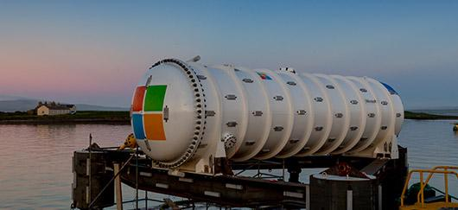

Proven concepts
12 racks
864 Servers
27.6 petabytes of disk.
Electricity consumption equivalent to 563 EU Houses
Microsoft Natick
Underwater data center
240 kW
Power consumption
14.3m length
12.7m width
References:
https://natick.research.microsoft.com
Notes:
12 racks
864 Microsoft datacenter
27.6 petabytes of disk.

Slide 5
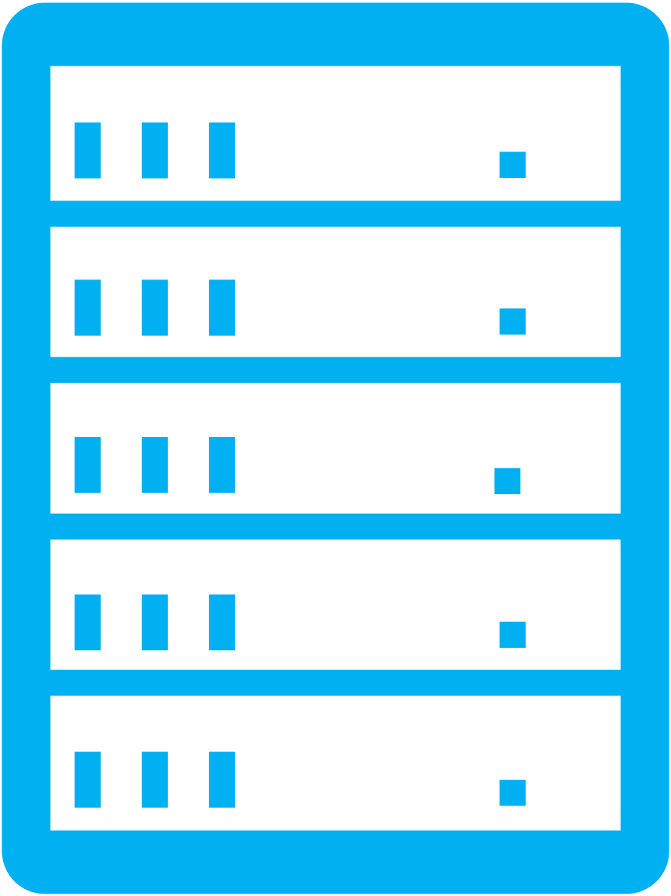




Power breakdown
EU Energy mix for 2020
Cooling
Up to
30% (100 kW)
About
535 Tons of $CO_{2}$ per year
26.4% Renewable
23.58% Nuclear
Computing
Up to 70%
240 kW
50.02 % Fossil
240 kW Data Center
References:
https://www.globalpetrolprices.com/energy_mix.php?countryId=221
https://teamsilverback.com/knowledge-base/data-center-power-series-2-watts-amps-and-btus/
https://www.researchgate.net/publication/317308758_Cooling_Energy_Consumption_Investigation_of_Data_Center_IT_Room_with_Vertical_Placed_Server
Notes:
CO2
Precio
Casas

Slide 6
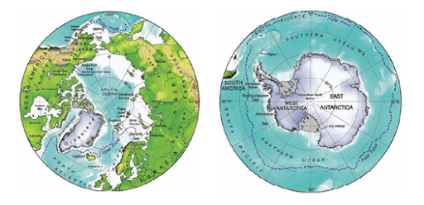
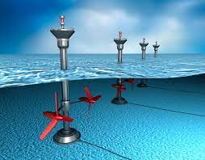
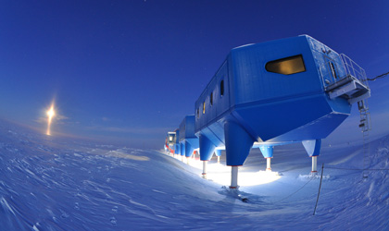
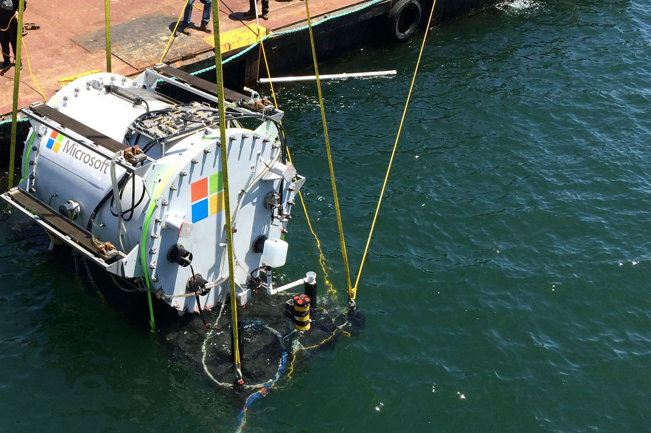
Potential customers
Energy matrix of Arctic countries
Research facilities
W&T power equipment supplier
Underwater datacenters

Slide 7



Finance
37%
Expected growth
CAGR
2020-2027
Levelized cost of electricity LCOE
Diesel generator 436€ /MWh
Tidal energy –
175 – 250 € /MWh
Wave energy –
100 - 150€ /MWh
Biogas– 137€ /MWh
References:
https://arena.gov.au/assets/2020/12/tidal-energy-in-australia.pdf
https://europa.eu/capacity4dev/file/29381/download?token=Yp_EN2wg
https://renewablesnow.com/news/minesto-says-lcoe-below-eur-50mwh-possible-for-kite-turbine-586850/
https://www.businesswire.com/news/home/20210212005455/en/Global-Wave-and-Tidal-Energy-Industry-2020-to-2027---Market-Trajectory-Analytics---ResearchAndMarkets.com

Slide 8


Proposed concept
Development of a platform able to represent the potential usage of tidal and wave power through the analysis of sea water velocity, sea depth, swell wave height and swell wave period.

Slide 9
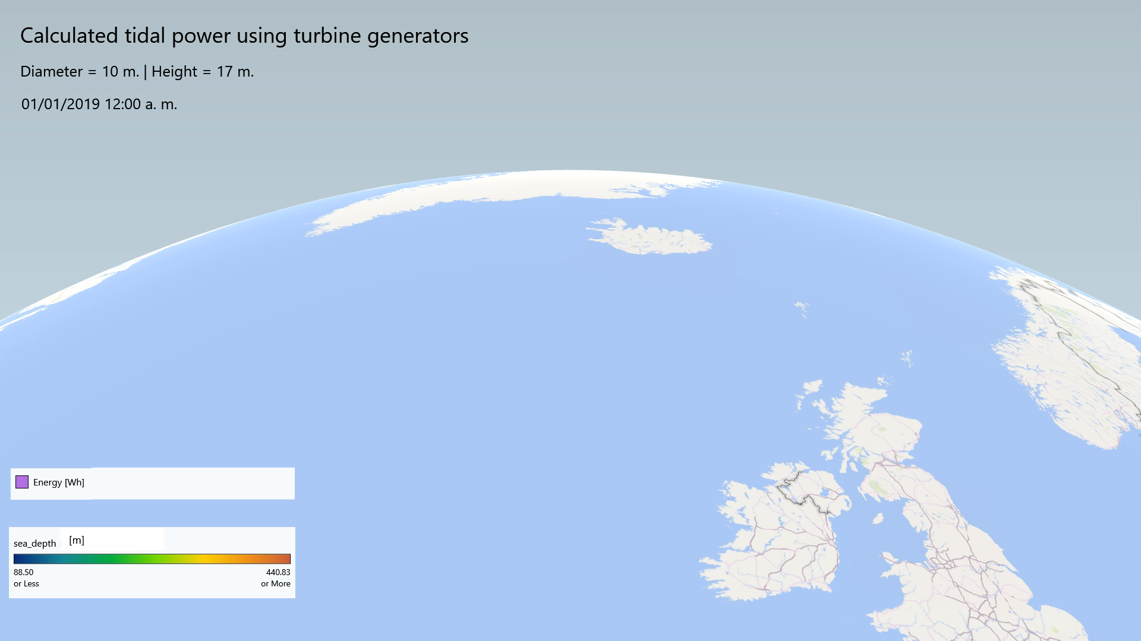
Visualizations

Slide 10
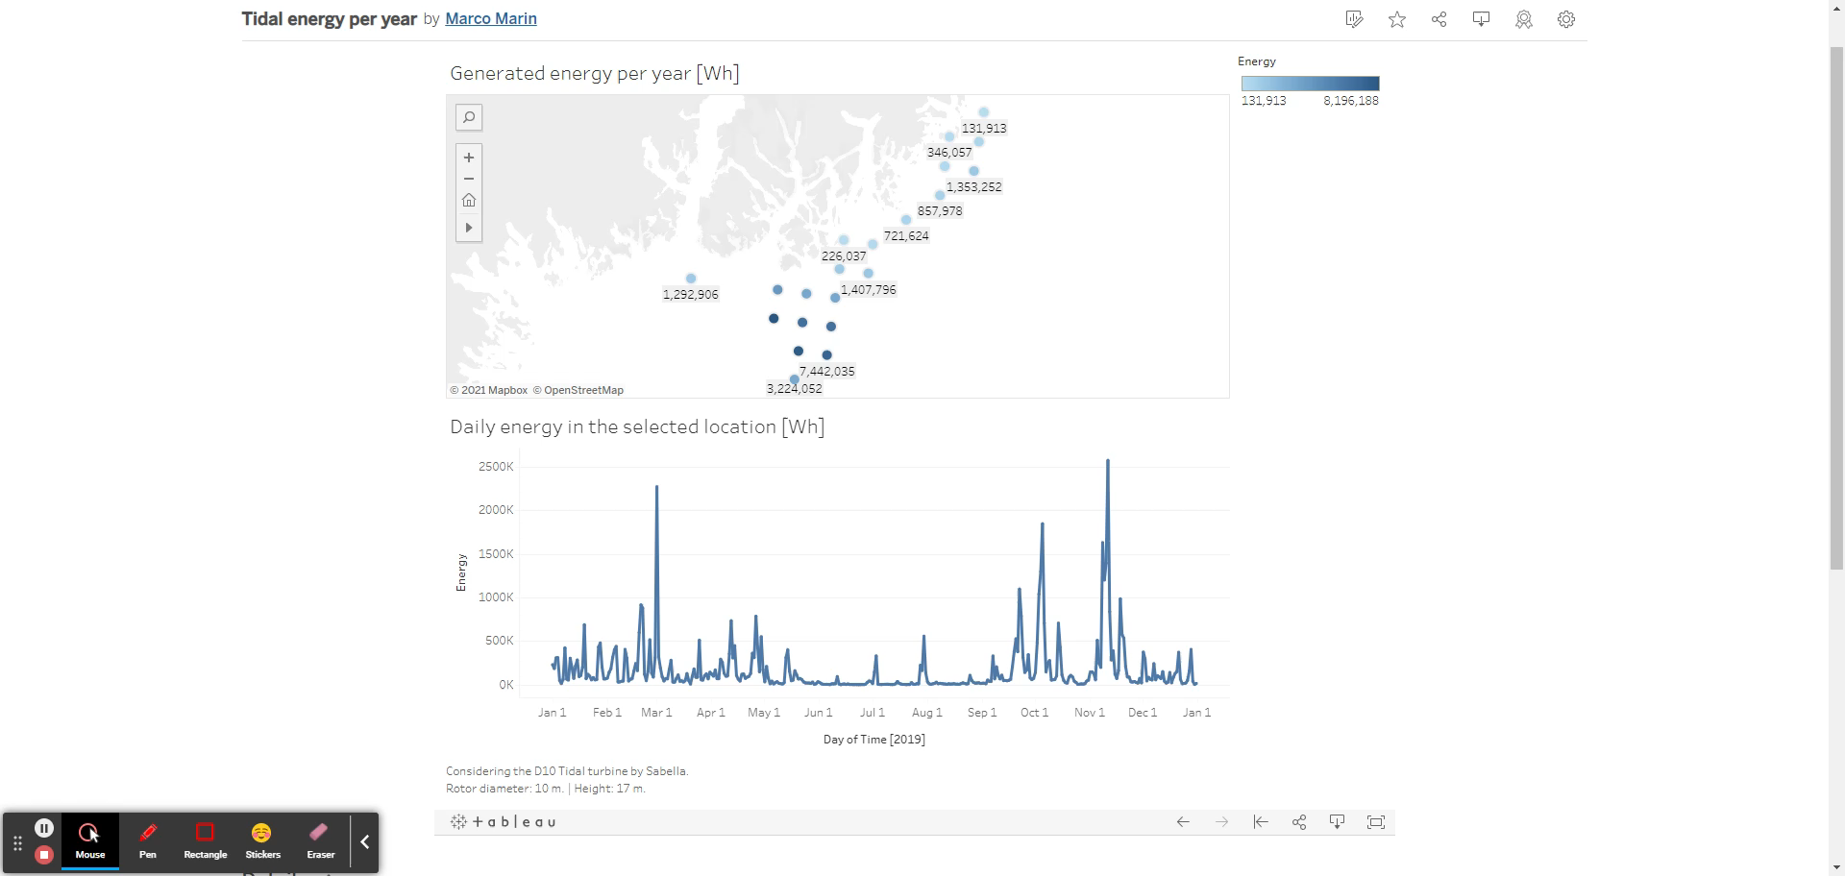

Slide 11
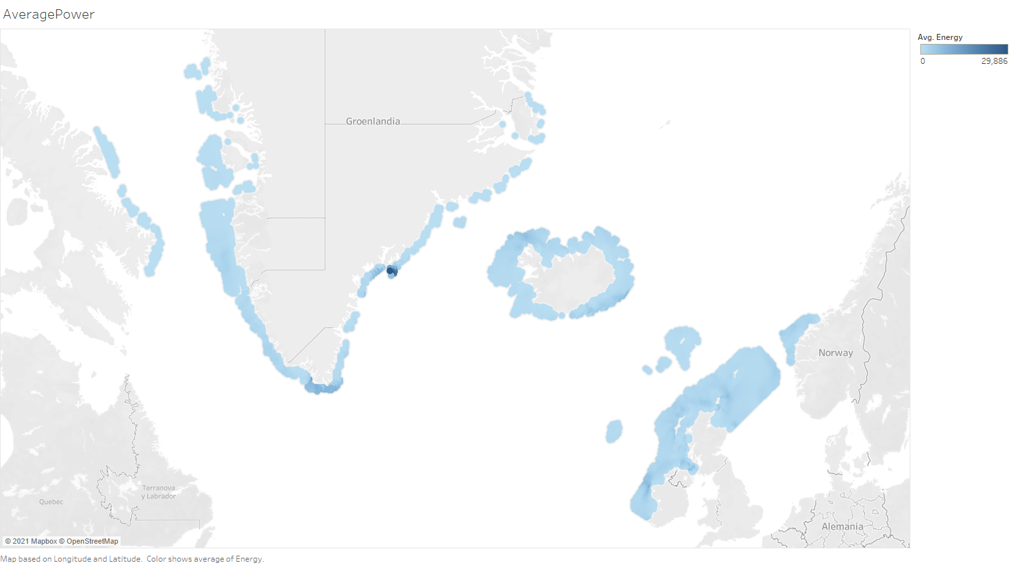

Slide 12
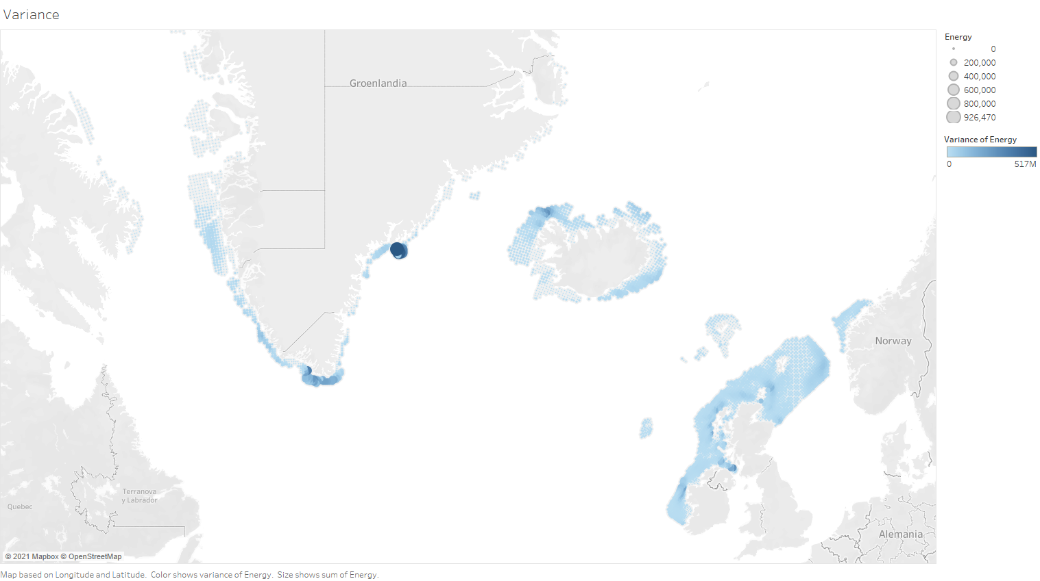

Slide 13
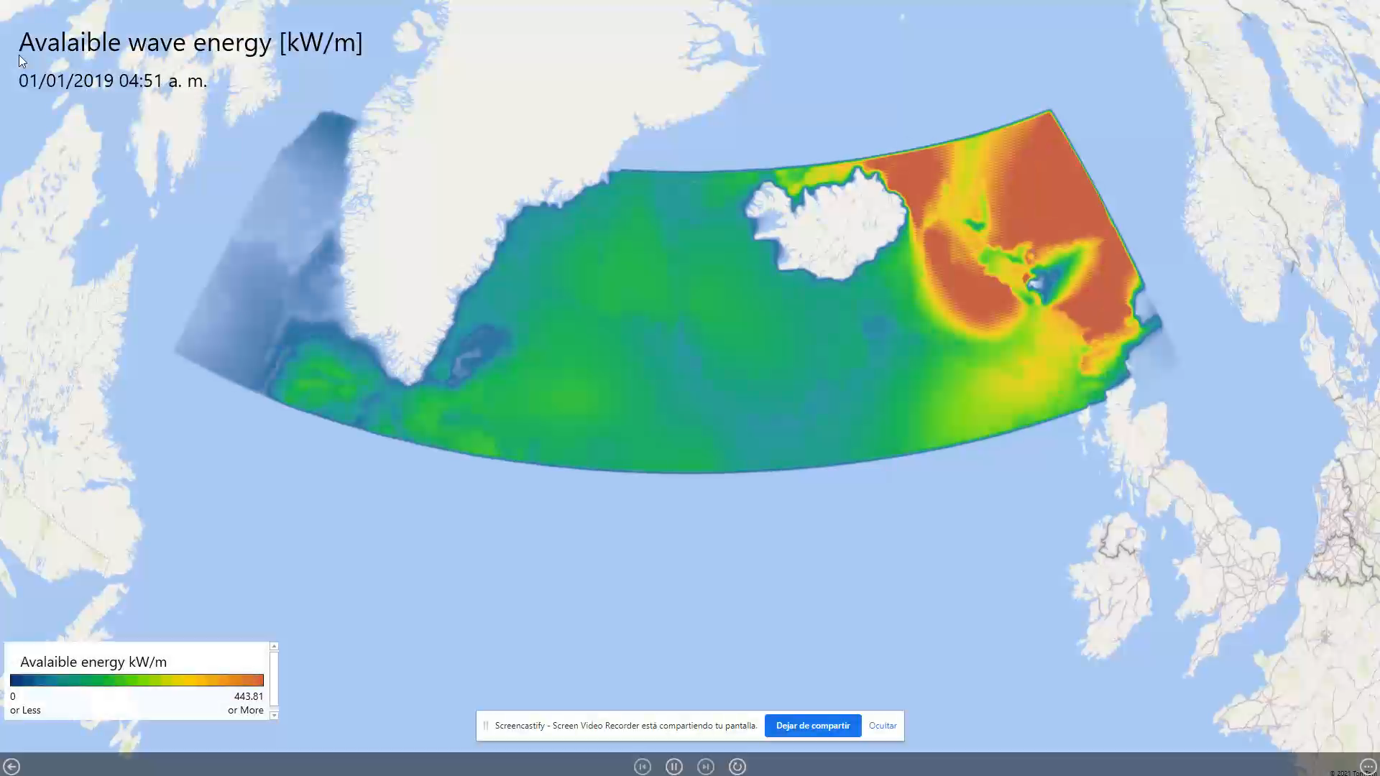

Slide 14
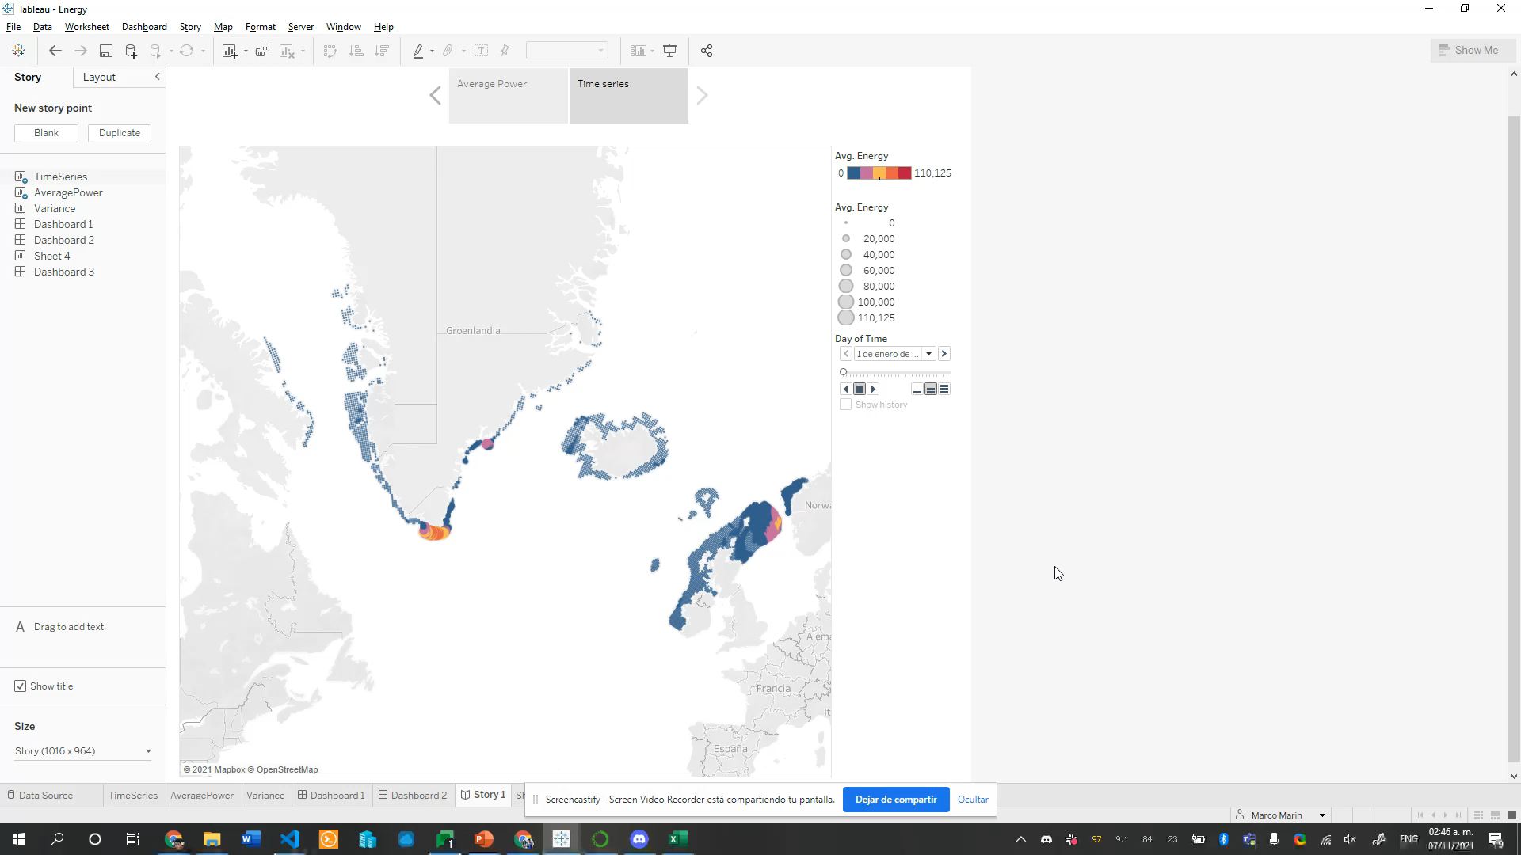

Slide 15
Roadmap
CASSINI
Hackathon 5-7 November
Data analysis ✓
Market analysis.
Data analysis of several years and areas
Initial version of the visualization ✓
Define technologies and infrastructure to use.
Add cost features and payback analysis.
Strategy definition
Make more specific analyses
considering the devices in the
market for harvesting the energy.
Incorporate Biogeochemistry data to minimize the wildlife impact.
Add operative data: ice speed and direction.

Slide 16


Acknowledgements

